Slide 1

DESIGN OF EXPERIMENTS
-AN OVERVIEW and METHODOLOGY
Lingfei Wei
8/13/2019

Slide 2
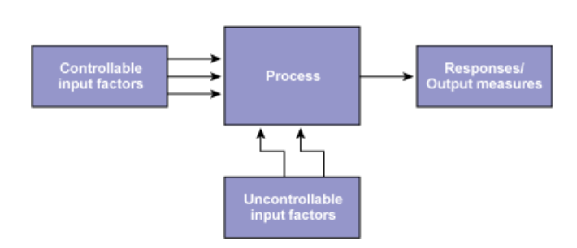
What is DOE
a powerful data collection and analysis tool that can be used in a variety of experimental situations

Slide 3
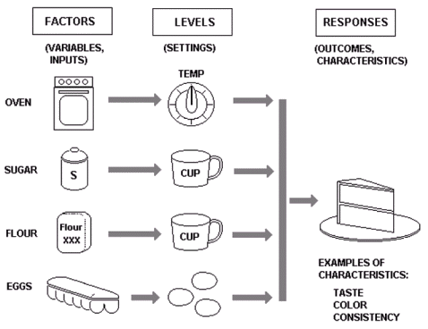
Why DOE
Comparing Alternatives
Identifying the Significant Inputs (Factors) affecting an Output (Response)
Achieving an Optimal Process Output (Response)
Minimizing, Maximizing, or Targeting an Output (Response)
Reducing Variability
Balancing Tradeoffs

Slide 4

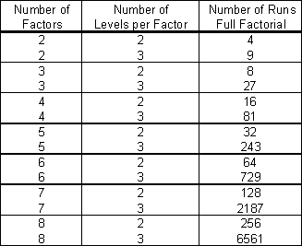

Strategical DOE
Randomly design
Full factorial design
Reduction or minimization of total number of trials.
Helps with statistical efficiency
How?

Slide 5
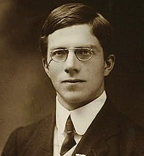

DOE terminology
Fisher's principles:
Comparison
Randomization
Statistical replication
Blocking
Orthogonality
Balance
Factorial experiments
(1890-1962)
Ronald Fisher
Notes:
The Arrangement of Field Experiments (1926) and The Design of Experiments (1935)
a certain lady could distinguish by flavour alone whether the milk or the tea was first placed in the cup
-randomization gives each individual unique chance to be examined in a research, so that can largely reduce human bias; At the same time, people should also be careful about randomization when using small sample size. Randomization can bring unreal results.
-statistical replication: performing the same combination run more than once, thus repeat experiments can further strengthen the experiment's reliability and validity
-Blocking is to avoid any unwanted variations in the input or experimental process.
-Orthogonality ensures that all specified parameters can be estimated independent of any other

Slide 6
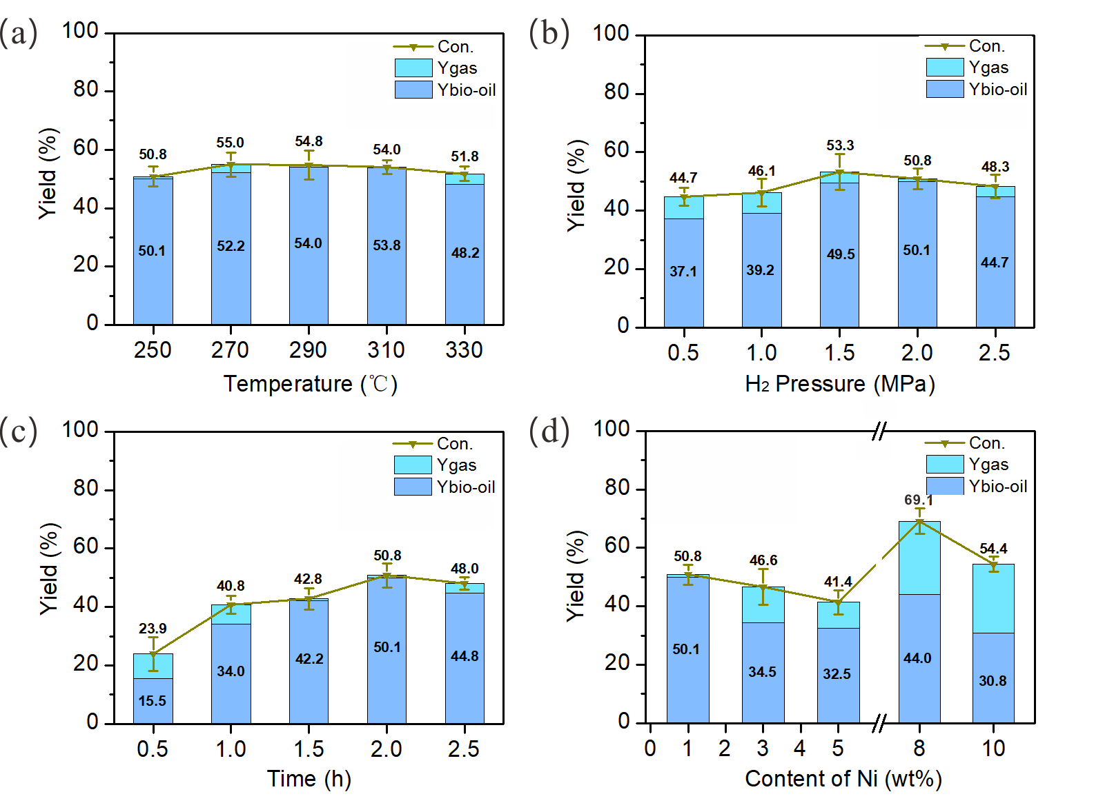
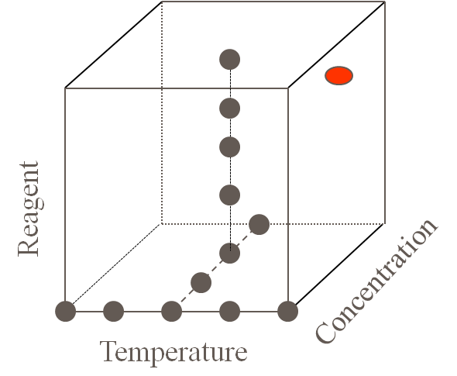
DOE Methodology
One-factor-at-a-time design
Factor z
Factor y
Factor x
The real case
Notes:
It is easy if only one factor is studied, but obviously, normally impossible

Slide 7
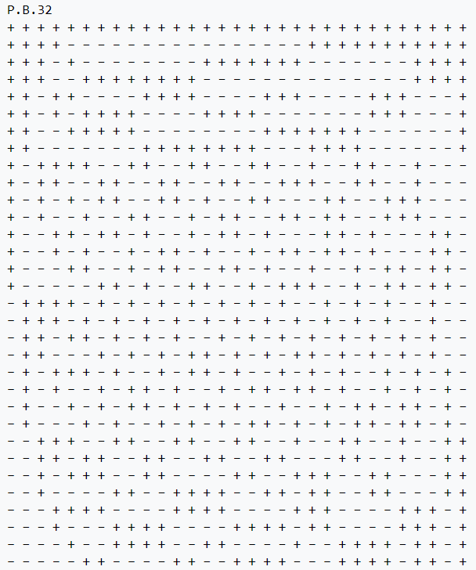
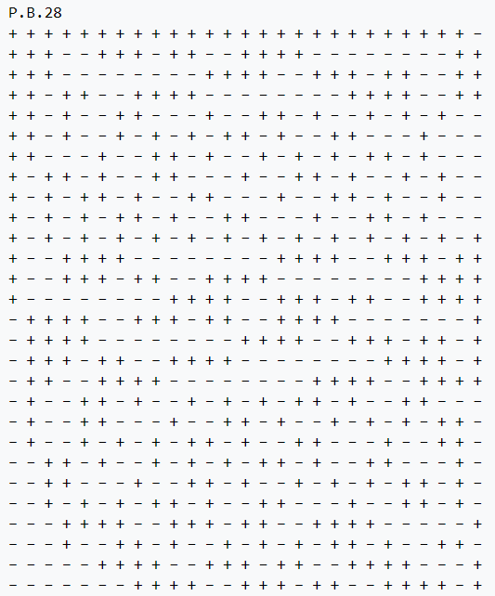
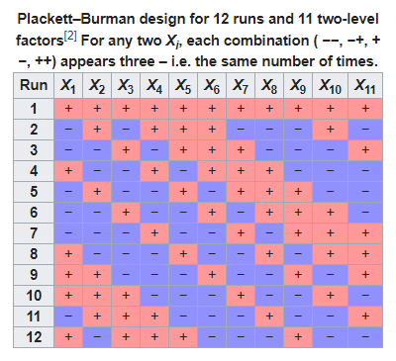
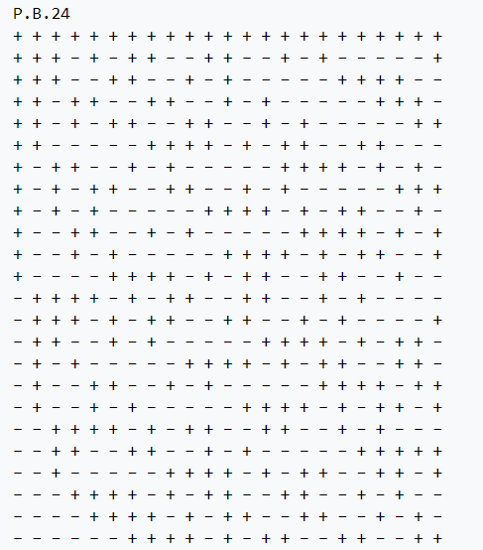
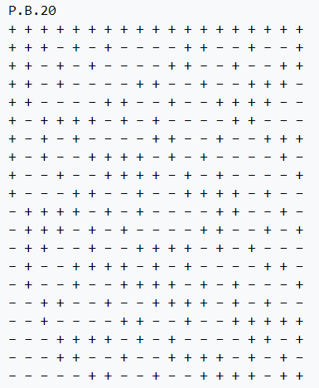
DOE Methodology
Plackett–Burman design (orthogonal two-level experimental design )
Criterion - each combination of levels for any pair of factors appears the same
number of times, throughout all the experimental runs.
Notes:
Mostly used two level factorial design
presented in 1946, while working in the British Ministry of Supply
A complete factorial design would satisfy this criterion, but the idea was to find smaller designs.
orthogonal two-level experimental design

Slide 8
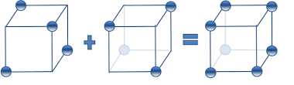
DOE Methodology
Fractional factorial design
Number of factors
5 factors, 2 levels experiment
I ^{k − p}
2 ⁵ = 32
2 ⁵⁻² = 8
Fraction size
Full factorial design
1/4 fractional factorial design
Number of levels of factors
2³⁻¹ fractional factorial
Fold-over
2³ full factorial
Notes:
A design with p such generators is a 1/(l^{p}) fraction of the full factorial design

Slide 9
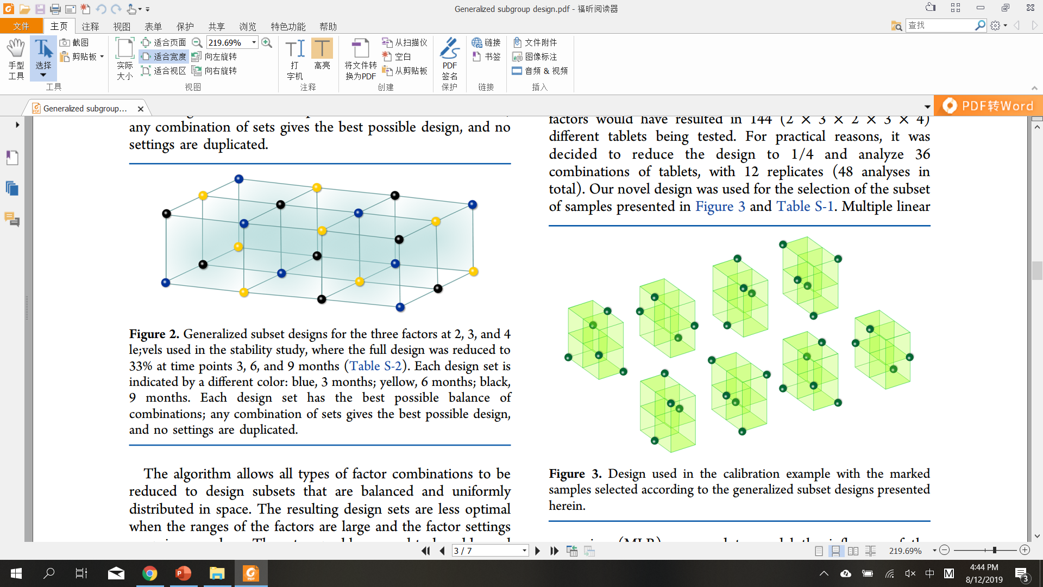
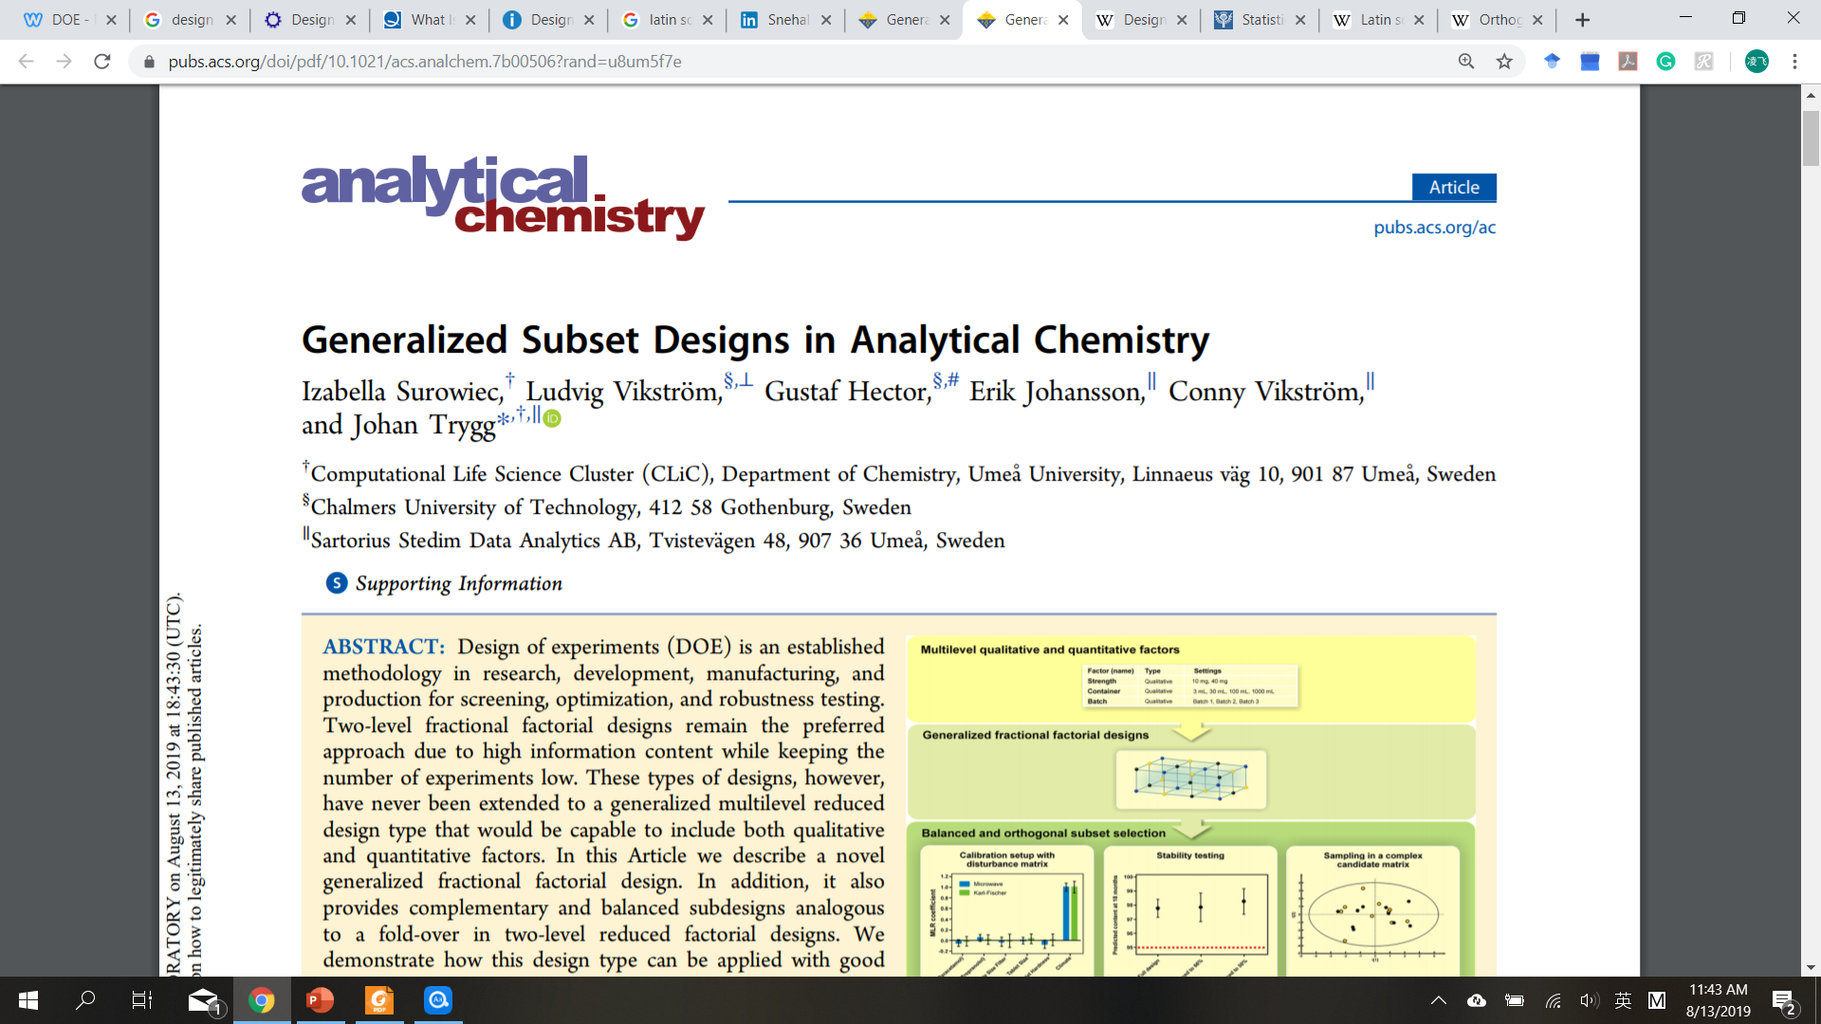
DOE Methodology
Generalized subset design
3 factors (4,3,2) experiment
Full factorial design: 4 x 3 x 2 = 24
1/3 GSD: 1/3 x 28 = 8
Notes:
A design with p such generators is a 1/(l^{p}) fraction of the full factorial design

Slide 10
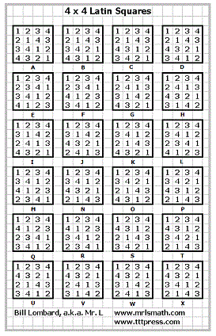
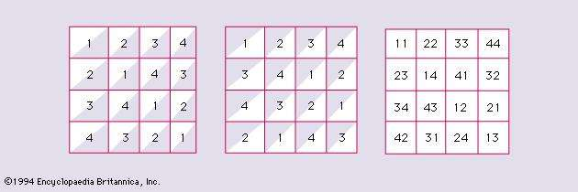
DOE Methodology
Latin Square
Reduced Latin Square
Equivalence classes of Latin squares
Orthogonal Latin Square
Notes:
an n × n array filled with n different symbols, each occurring exactly once in each row and exactly once in each column
normalized Latin square

Slide 11
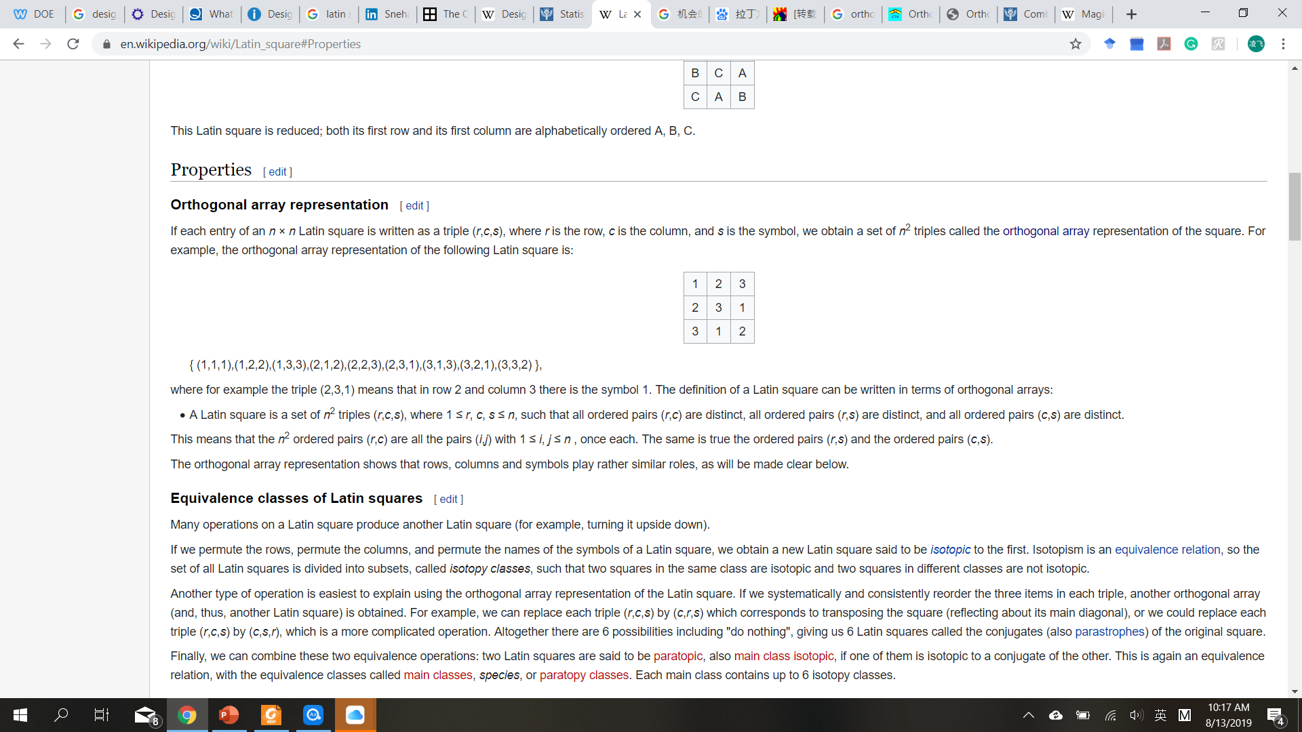
DOE Methodology
Latin Square
n=3
Row, column and symbol
{ (1,1,1),(1,2,2),(1,3,3),(2,1,2),(2,2,3),(2,3,1),(3,1,3),(3,2,1),(3,3,2) }
DOE: 3 factors, 3 levels
DOE: 4 factors, 3 levels ?
{ (1,1,1,1),(1,2,2,2),(1,3,3,3),(2,1,2,3),(2,2,3,1),(2,3,1,2),(3,1,3,2),(3,2,1,3),(3,3,2,1) }
Notes:
an n × n array filled with n different symbols, each occurring exactly once in each row and exactly once in each column
normalized Latin square

Slide 12

DOE Guidelines
To determine: the factors to be tested; the levels of those factors; the structure and layout of experimental runs, or conditions.
To consider: unexplained variables; Uncontrollable factors (noise factors); correlation between factors.
To decide a DOE method.
To collect data: conduct experiments, minimize experimental error.
To analyze results using statistical methods (F-test, ANOVA).
To conclude results, to determine practical significance and to make recommendations.

Slide 13
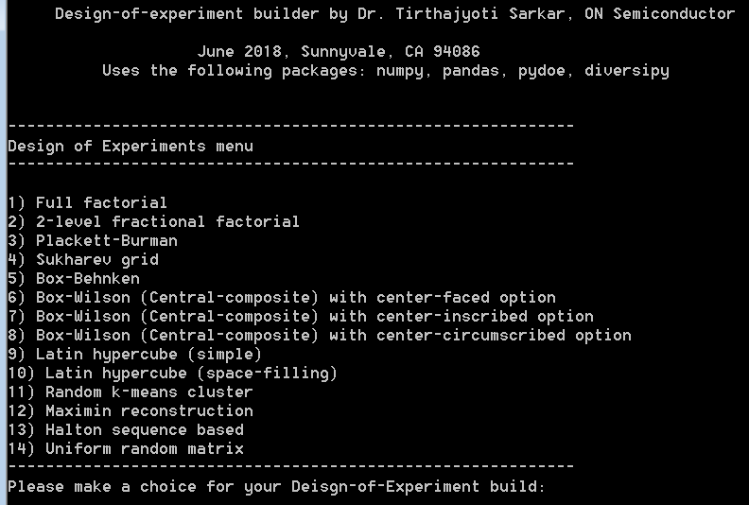
DOE & Coding
Python: https://github.com/tirthajyoti/Design-of-experiment-Python
Copyright (c): 2018-2028, Dr. Tirthajyoti Sarkar, Sunnyvale, CA 94086

Slide 14
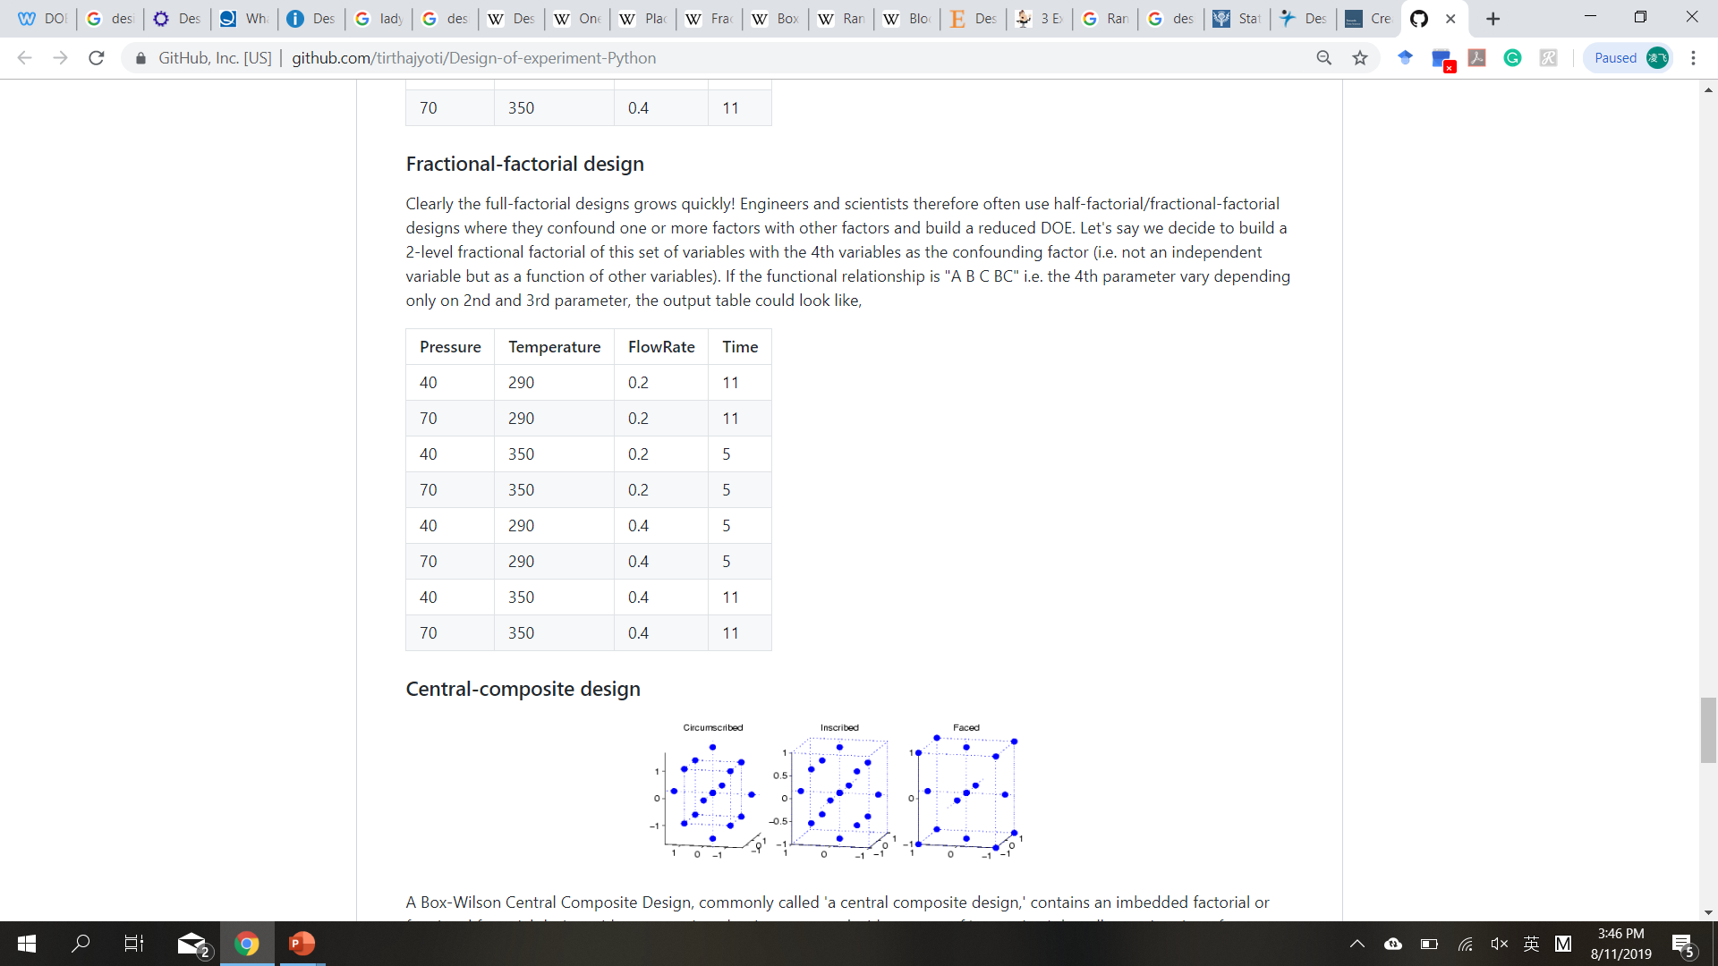
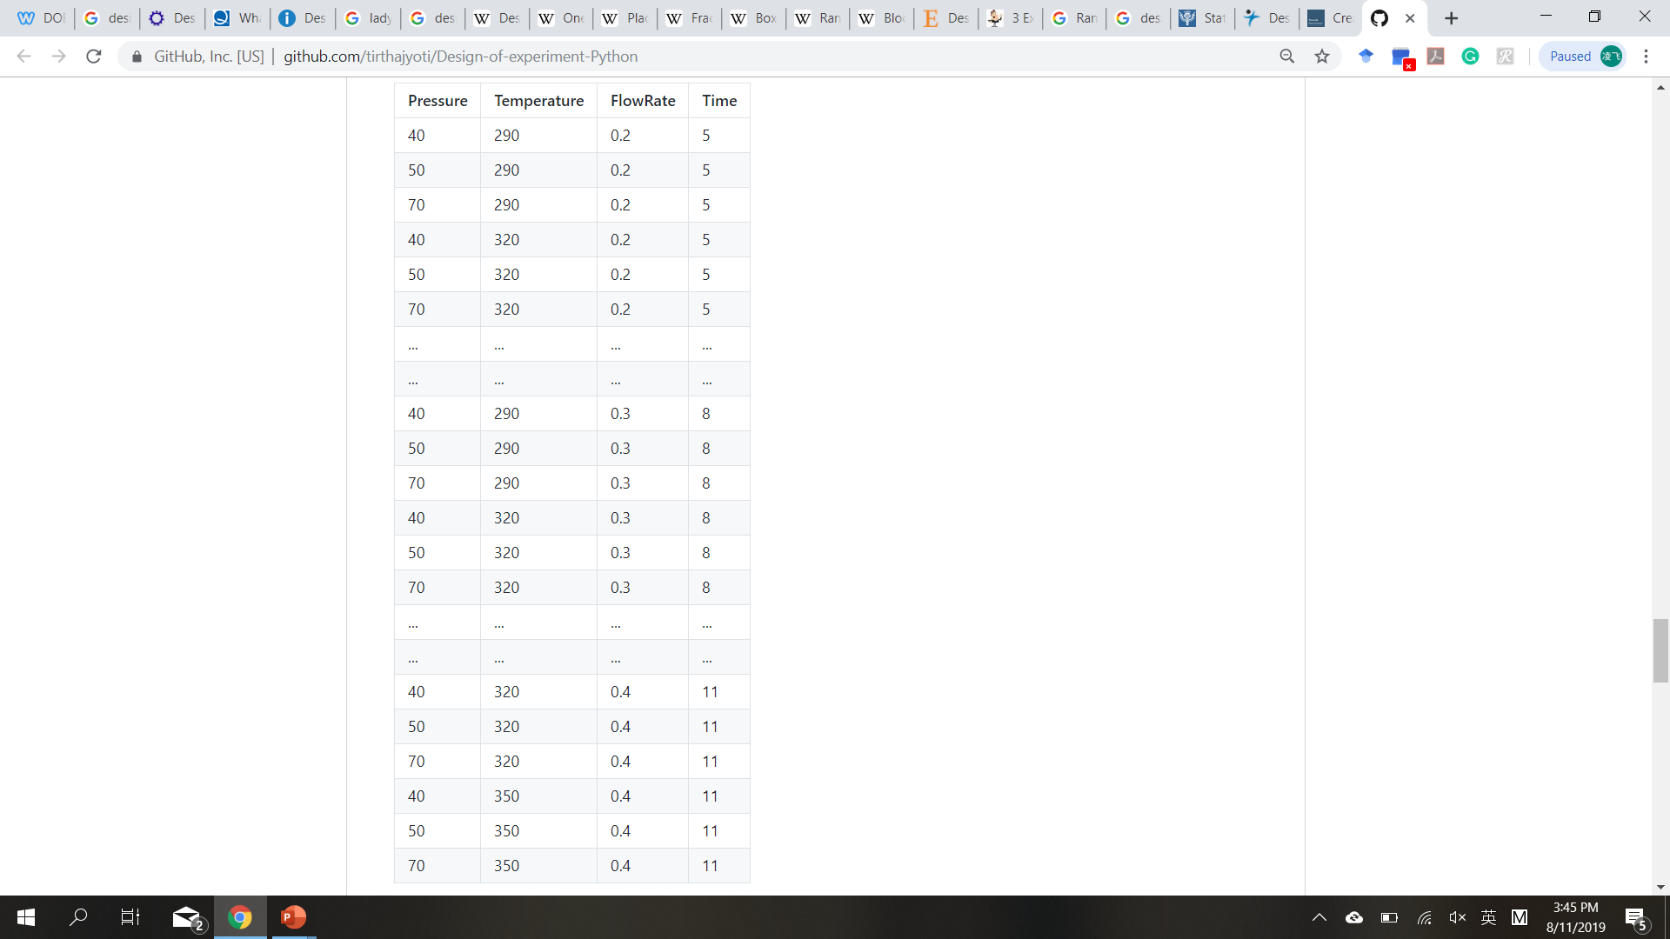
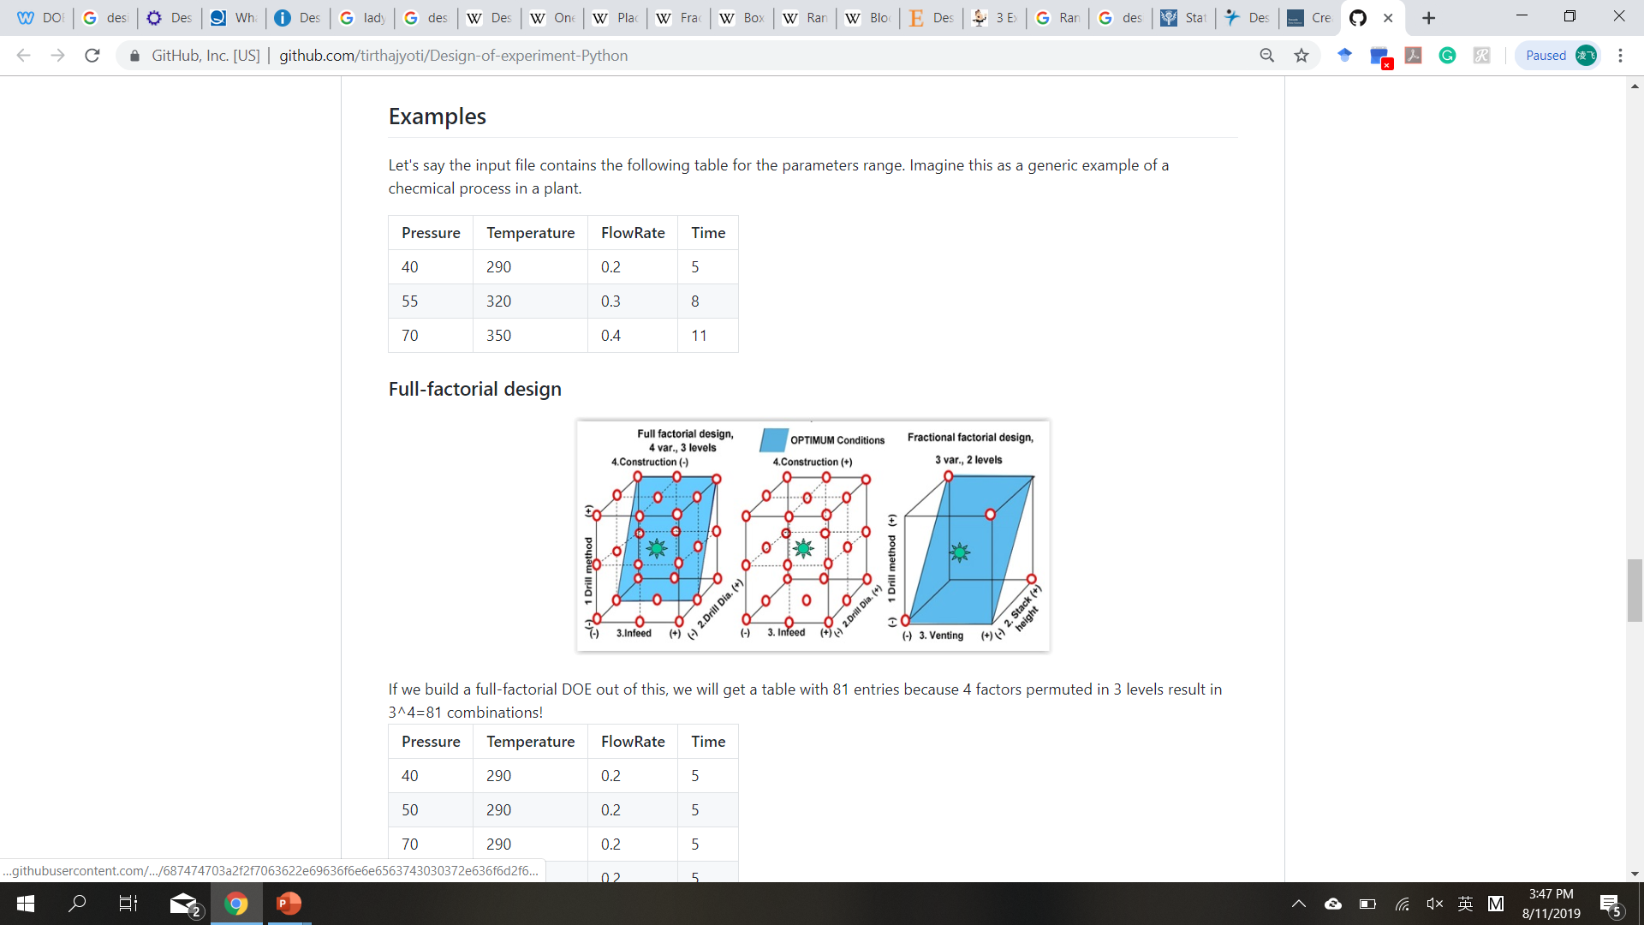
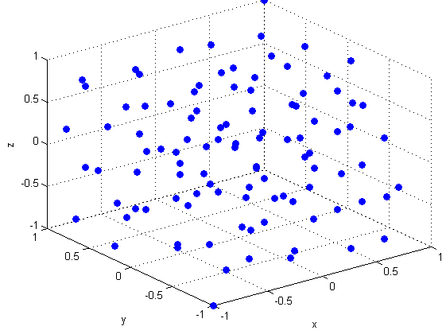
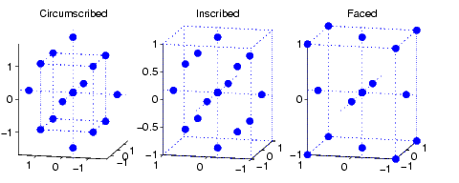
DOE & Coding
Fractional factorial
Full factorial
Python: https://github.com/tirthajyoti/Design-of-experiment-Python
Central-composite design
Latin Hypercube design

Slide 15
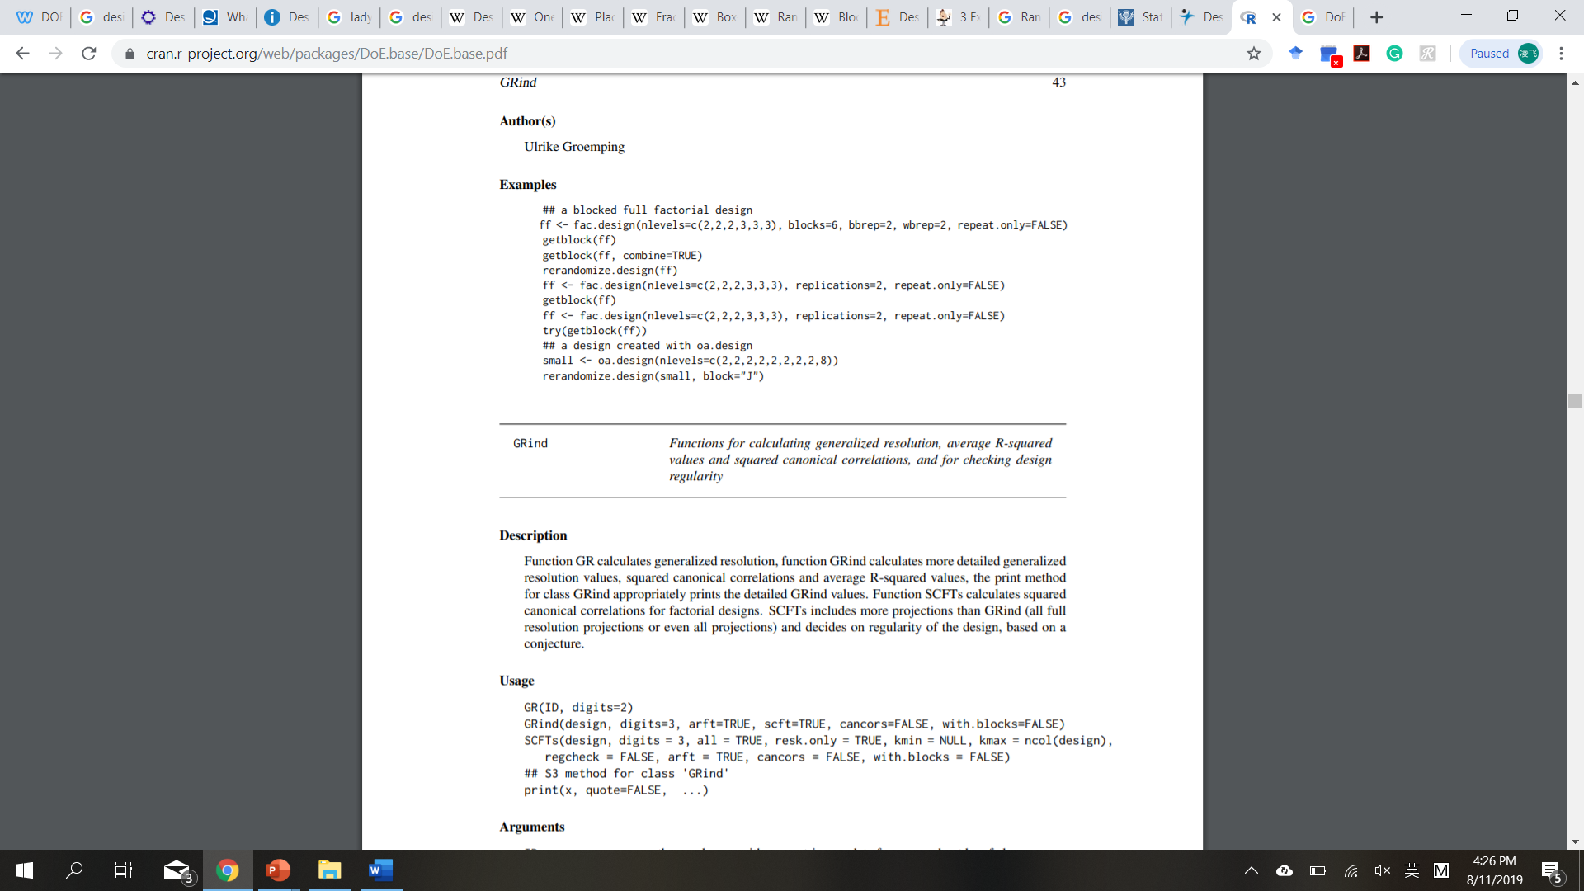
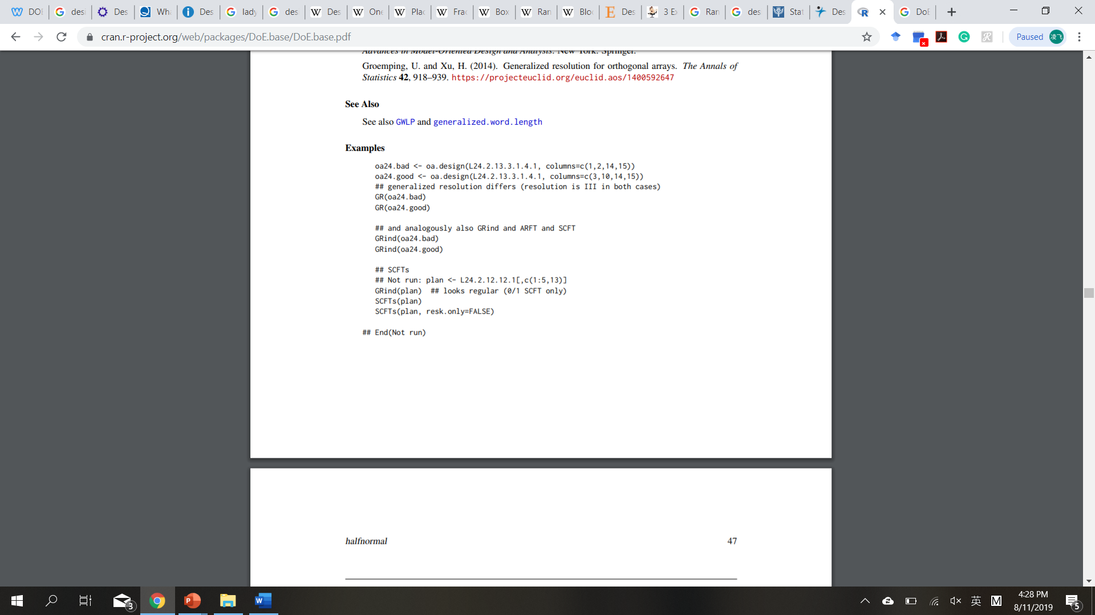
DOE & Coding
R: DoE.base (Full Factorials, Orthogonal Arrays and Base Utilities for DoE Packages)
Grömping U (2018). “R Package DoE.base for Factorial Experiments.” Journal of Statistical Software, 85(5), 1–41. doi: 10.18637/jss.v085.i05.
https://CRAN.R-project.org/package=DoE.base

Slide 16
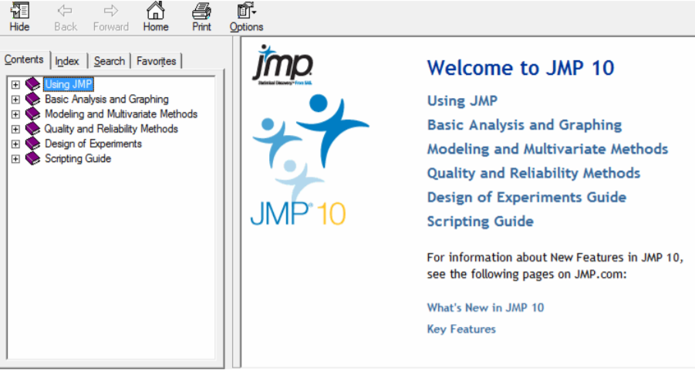

DOE & Coding
JMP® 10 Design of Experiments Guide: https://www.jmp.com/support/downloads/pdf/jmp1001/doe_guide.pdf
Copyright © 2012, SAS Institute Inc., Cary, NC, USA

Slide 17
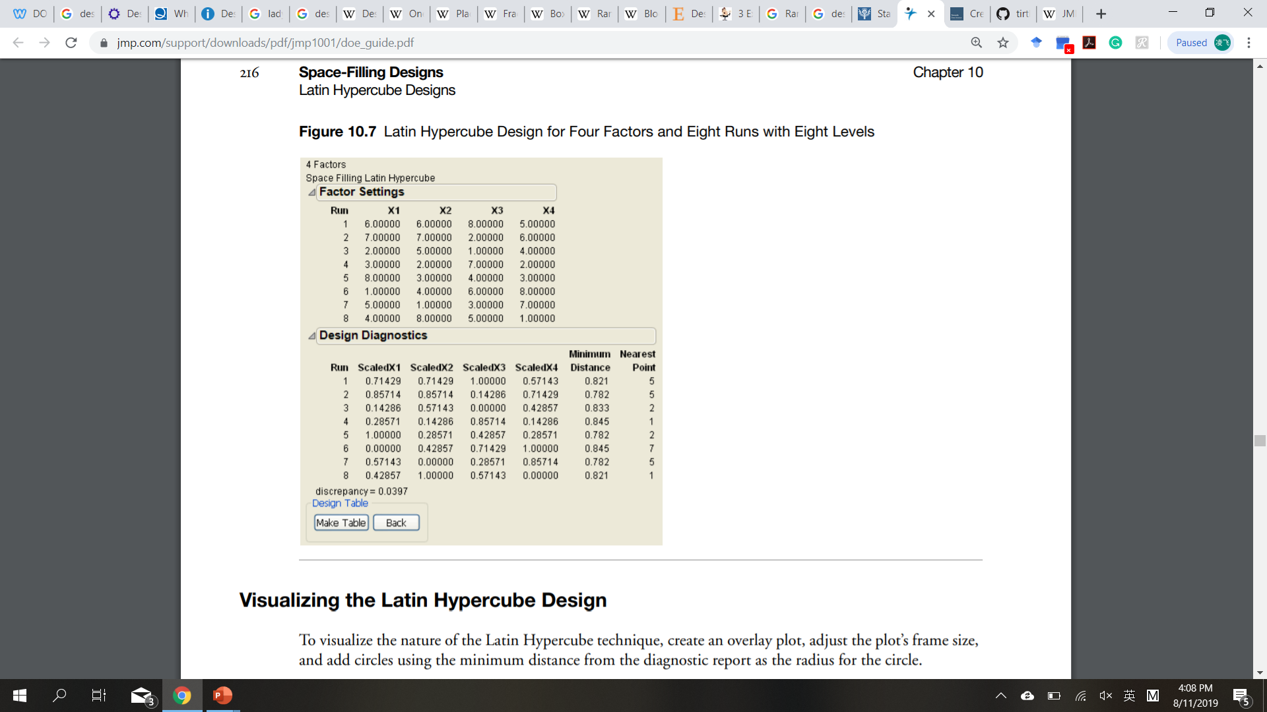
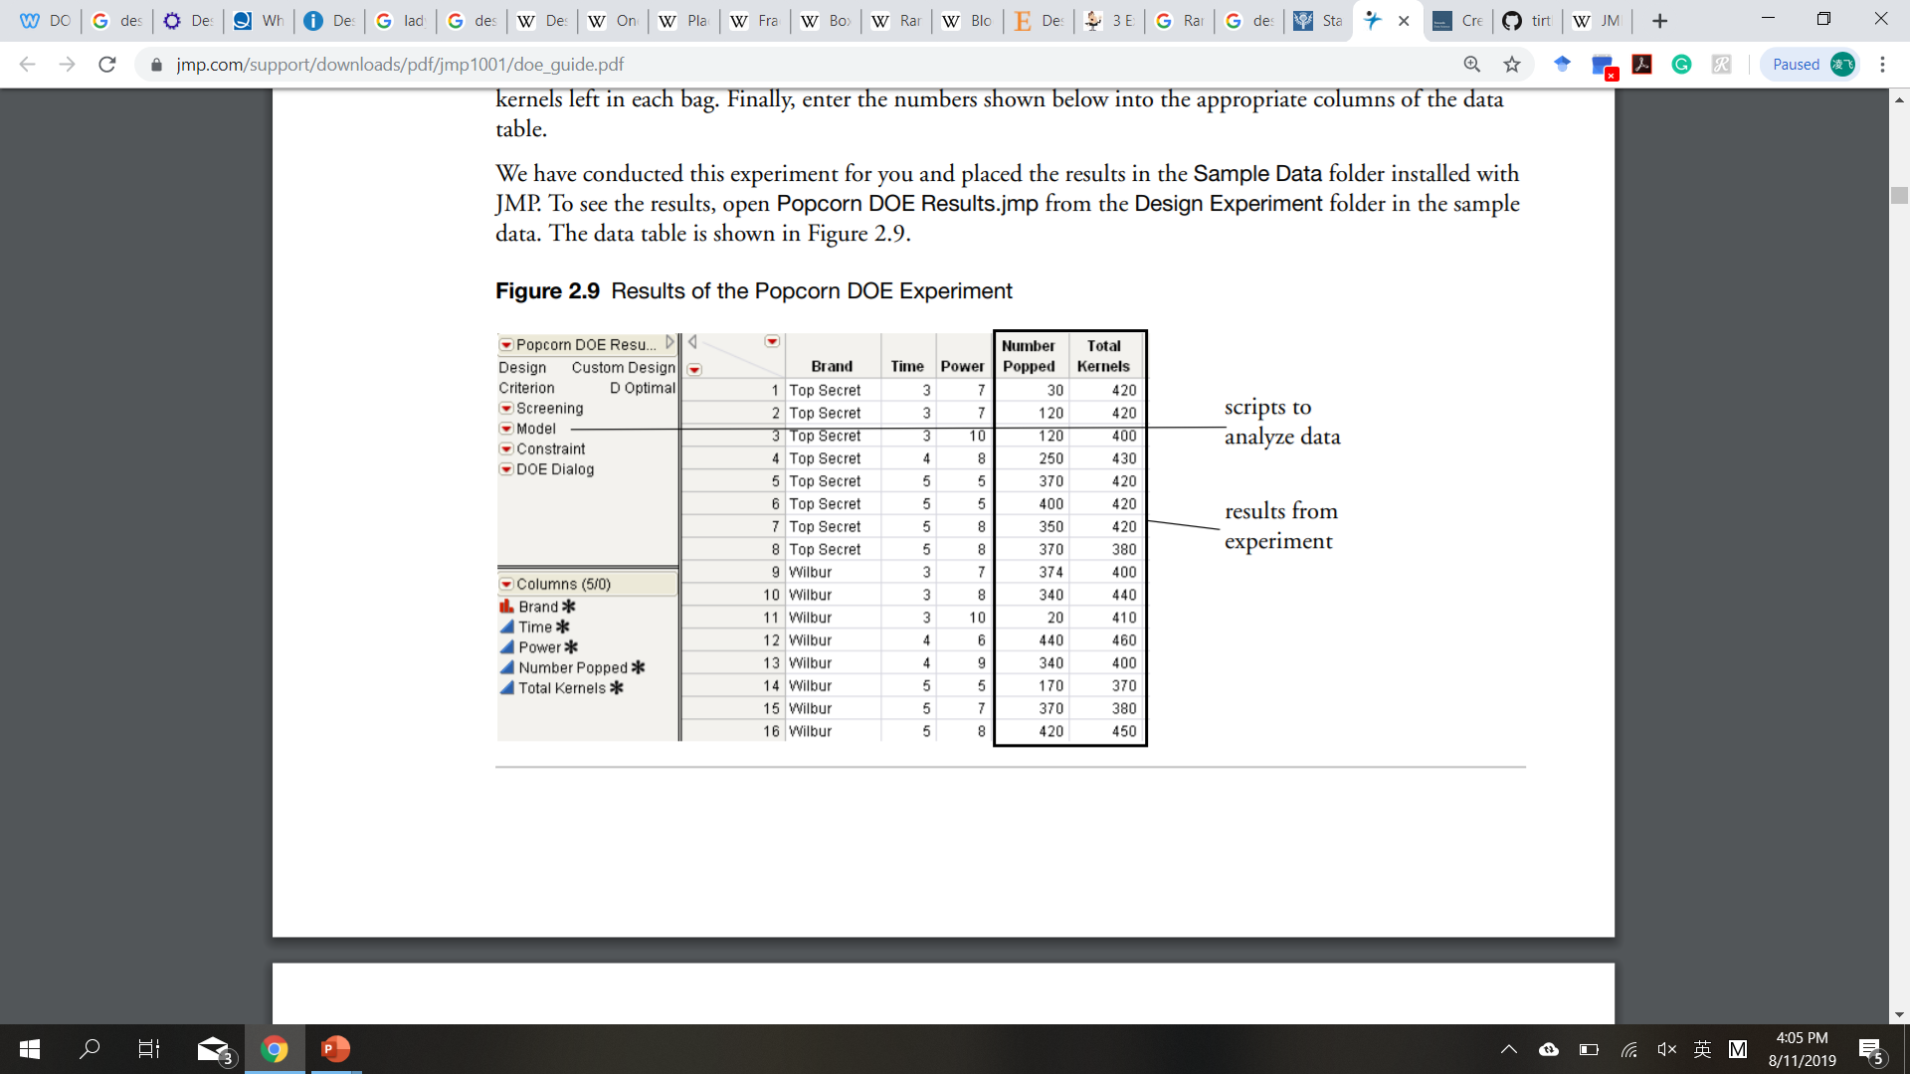
DOE & Coding
JMP® 10 Design of Experiments Guide: https://www.jmp.com/support/downloads/pdf/jmp1001/doe_guide.pdf

Slide 18
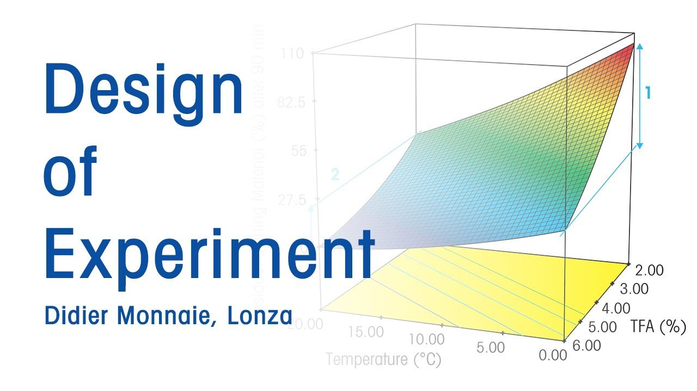
Thank you!

